Slide 1
Modify Tables and Fields
Microsoft Access 2013
Lesson 4

Slide 2
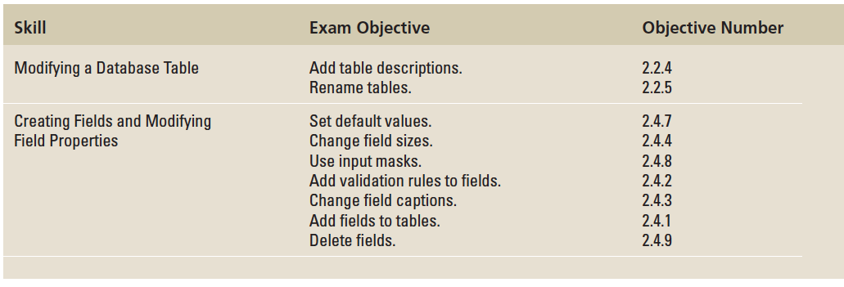
Objectives

Slide 3
Step by Step: Modify Table Properties
GET READY. Before you begin these steps, be sure to launch Microsoft Access.
OPEN the Events database from the data files for this lesson.
SAVE the database as EventsXXX (where XXX is your initials).
In the Navigation Pane, double-click Events to open that table.
On the Home tab, in the Views group, click the bottom half of the View button, and then click Design View from the menu that appears.

Slide 4
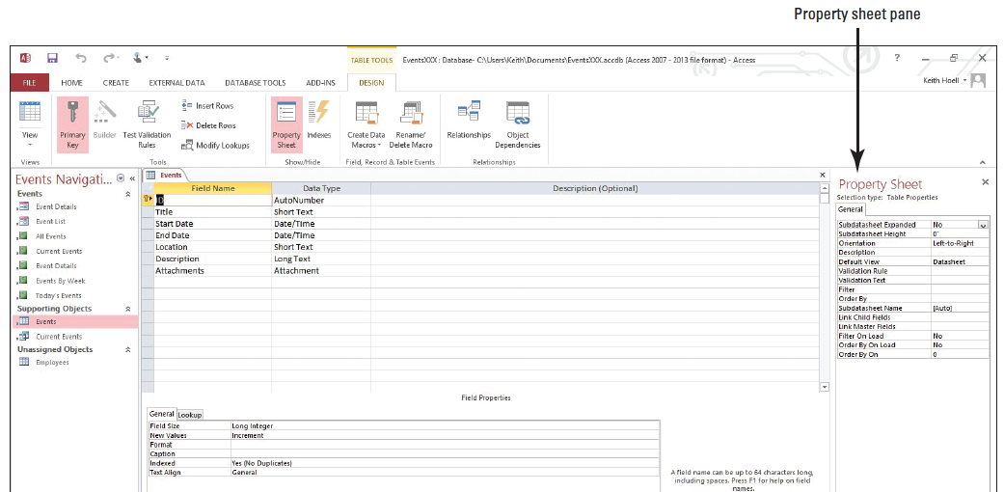
Step by Step: Modify Table Properties
On the Design tab, in the Show/Hide group, click Property Sheet. The Property Sheet pane appears on the right of the Access window (below).
Place the insertion point in the property box for Description.

Slide 5
Step by Step: Modify Table Properties
Press Shift+F2 to open the Zoom box (see Figure 4-2) to provide more space.
Key Most popular events for 2014.
Click OK.
Click the Close button on the Property Sheet pane to close it.
Click the File tab and click Save to save the design changes you have made to the table.
Click the Close ‘Events’ button to close the table.
PAUSE. LEAVE the database open to use in the next exercise.

Slide 6
Step by Step: Rename a Table
USE the database that is open from the previous exercise.
On the Create tab, in the Templates group, click the Application Parts button and click Comments to create a new table.
In the Create Relationship dialog box that appears, select There is no relationship and then click Create.

Slide 7
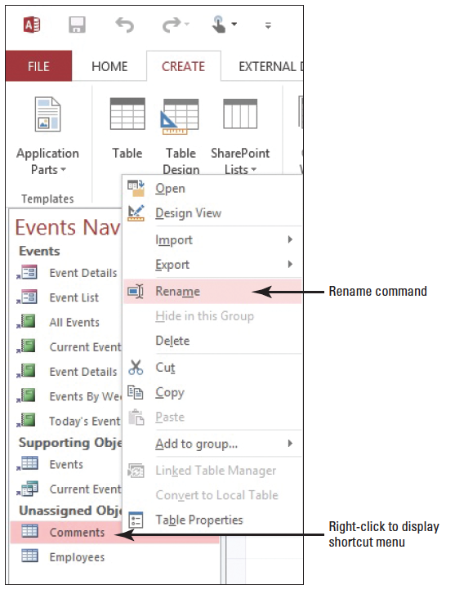
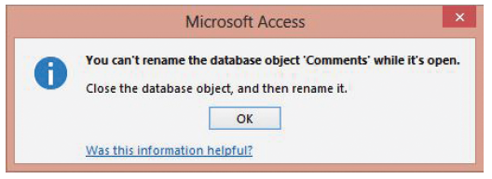
Step by Step: Rename a Table
Open the Comments table and right-click Comments in the Navigation Pane to display the shortcut menu shown at right. Select Rename and a dialog box appears that states You can’t rename the database object ‘Comments’ while it’s open, (below). Close the dialog box.

Slide 8
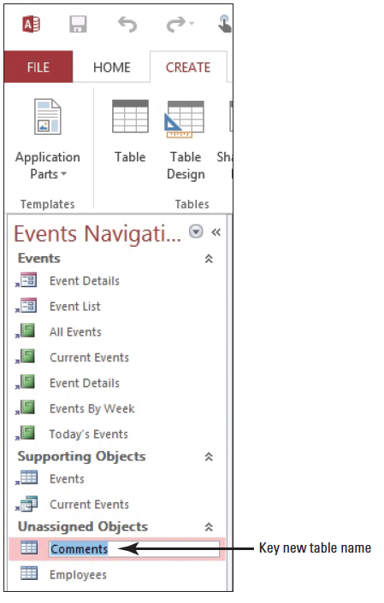
Step by Step: Rename a Table
Close the Comments table. The table closes.
Right-click Comments in the Navigation Pane to display the shortcut menu.
Click Rename. The table name is now selected for renaming (right).
Key Event Comments and press Enter. The table has been renamed.
PAUSE. LEAVE the database open to use in the next exercise.

Slide 9
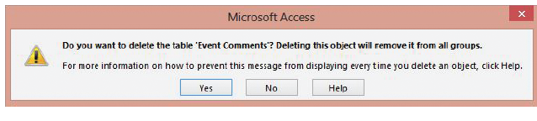
Step by Step: Delete a Table
USE the database that is open from the previous exercise.
Right-click the Event Comments table in the Navigation Pane and click Delete on the shortcut menu. A confirmation message appears (below).
Click Yes to delete the table.
PAUSE. LEAVE the database open to use in the next exercise.
Notes:
Take Note: If the table was related to one or more additional tables, Access would ask if you wanted to delete those relationships before deleting the table.
Cross Reference: You can also delete information from individual records or delete entire records from a table, as you learned in Lesson 3.

Slide 10
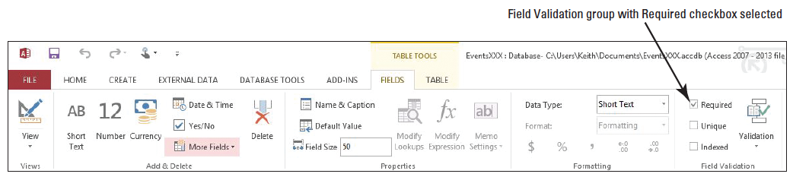
Step by Step: Set a Field Property in Datasheet View and Design View
USE the database that is open from the previous exercise.
Double-click the Events table in the Navigation Pane to open the table in Datasheet view, if it is not already open.
Click the Location column header to select that field.
Click the Required check box in the Field Validation group on the Table Tools Fields contextual tab (below). This setting determines that a value must be entered in the Location field for all records in the table.

Slide 11
Step by Step: Set a Field Property in Datasheet View and Design View
On the Home tab, in the Views group, click the bottom half of the View button and click Design View.
In the Field Name column in the middle portion of the table design grid, click in the Location cell.
In the Default Value row in the lower portion of the table design grid, click in the property box and key To Be Announced to specify a value that will be automatically entered in this field for new records.
In the Field Name column in the upper portion of the table design grid, click in the Title cell.
In the Field Size row in the lower portion of the table design grid, select 150 in the property box and key 175 to change the maximum number of characters you can enter in the Title field.
PAUSE. LEAVE the database open to use in the next exercise.

Slide 12
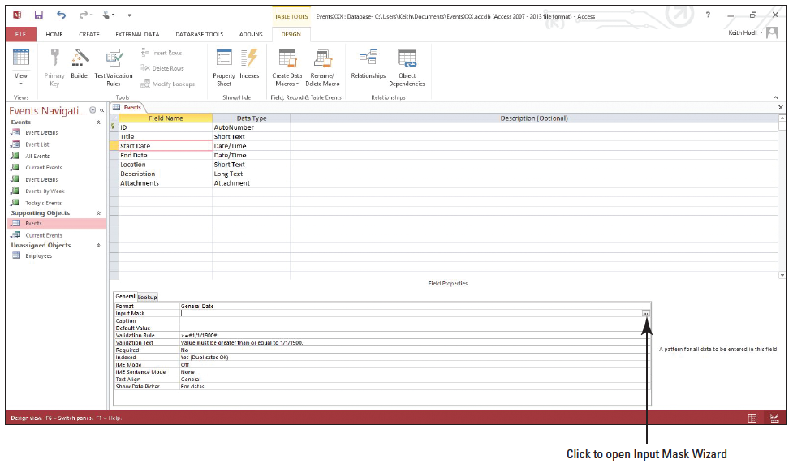
Step by Step: Define Input Masks for Fields
USE the database that is open from the previous exercise.
In the Field Name column in the upper portion of the table design grid, click in the Start Date cell.
Click the Input Mask property box in the lower portion of the table design grid to display the Input Mask Wizard button (...) on the far right of the cell (right).

Slide 13
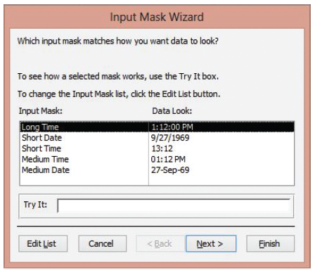
Step by Step: Define Input Masks for Fields
Click the Input Mask Wizard button. A message box appears asking if you want to save the table now.
Click Yes to close the message box and display the Input Mask Wizard (right).

Slide 14
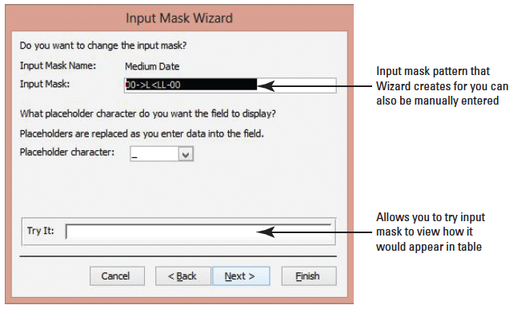
Step by Step: Define Input Masks for Fields
Click Medium Date, to select the DD-MON-YR date format, and then click Next >. The next screen in the Input Mask Wizard appears (below).

Slide 15
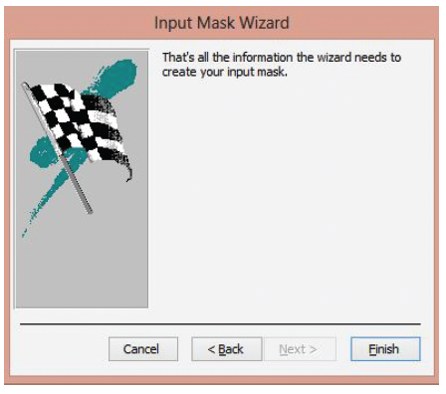
Step by Step: Define Input Masks for Fields
Click Next to accept the default settings in this screen and display the final Input Mask Wizard screen (right).

Slide 16
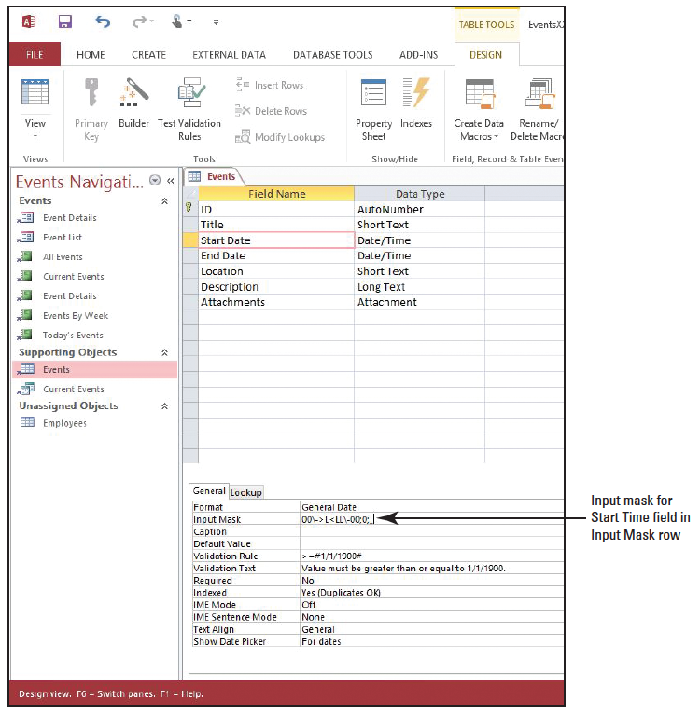
Step by Step: Define Input Masks for Fields
Click Finish. The input mask appears in the Input Mask row (right).
PAUSE. LEAVE the database open to use in the next exercise.

Slide 17
Step by Step: Allow Zero Length
USE the database that is open from the previous exercise.
In the Field Name column in the upper portion of the table design grid, click in the Description cell.
Click the Allow Zero Length property box in the lower portion of the table design grid to display the down arrow on the far right of the cell.

Slide 18
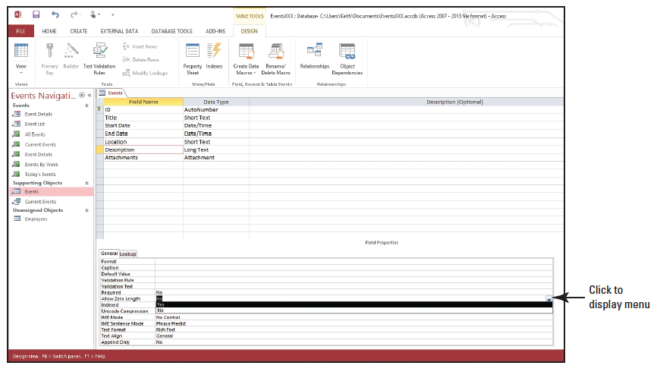
Step by Step: Allow Zero Length
Click the down arrow to display the menu (below).
Click Yes.
PAUSE. LEAVE the database open to use in the next exercise.

Slide 19
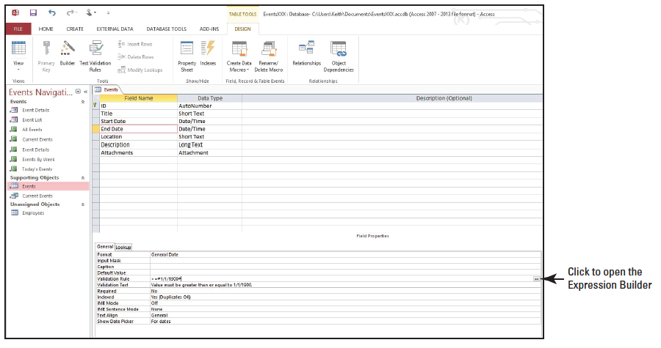
Step by Step: Set Data Validation Rules
USE the database that is open from the previous exercise.
In the Field Name column in the upper portion of the table design grid, click the End Date cell.
Click the Validation Rule property box in the lower portion of the table design grid to display the Ex- pression Builder button (...) on the far right of the cell (right).

Slide 20
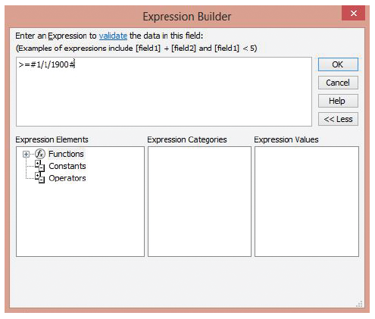
Step by Step: Set Data Validation Rules
Click the Expression Builder button to display the Expression Builder dialog box (right).
Select the number 1900 and replace it by keying 2014.
Click OK.

Slide 21
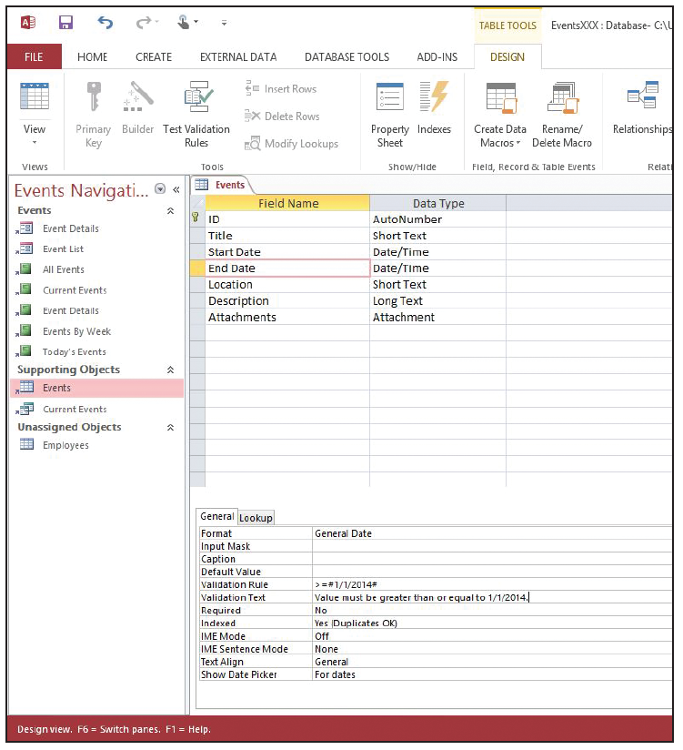
Step by Step: Set Data Validation Rules
Click the Validation Text property box in the lower portion of the table design grid.
Select the number 1900 and replace it by keying 2014. The property boxes should look like those shown at right.
PAUSE. LEAVE the database open to use in the next exercise.

Slide 22
Step by Step: Enter Captions
USE the database that is open from the previous exercise.
In the Field Name column in the upper portion of the table design grid, click the Location cell.
Click the Caption property box in the lower portion of the table design grid.
Key Venue. The caption property has now been set to Venue and will display as a column name in table Datasheet view, as well as labels for forms, reports, and queries.
PAUSE. LEAVE the database open to use in the next exercise.

Slide 23
Step by Step: Create Fields
USE the database that is open from the previous exercise.
On the Home tab, in the Views group, click the bottom half of the View button and click Datasheet View. Save the table, if required. If you get a message about data integrity, click Yes.
Notes:
Take Note: Whenever you add or modify field validation rules for fields that contain data, the data may violate these new rules. You can allow Access to test the data against the rules and inform you if there are any violations.

Slide 24
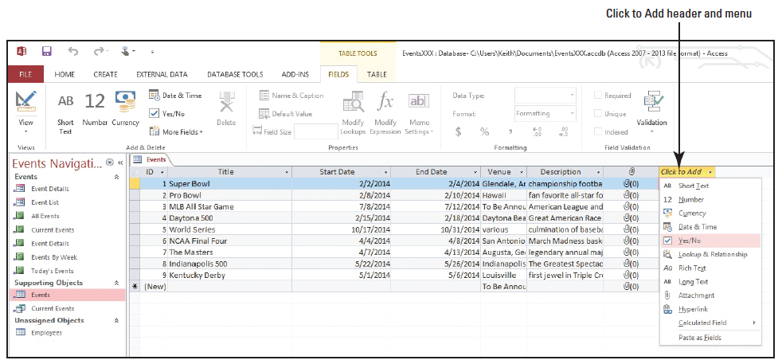
Step by Step: Create Fields
Scroll to the right of the Events table to display the last column and click the Click to Add header. Click Yes/No from the menu of available data types that appear (below). You are going to add a new field with the Yes/No data type in which you can indicate whether or not events will have on-site staff.

Slide 25
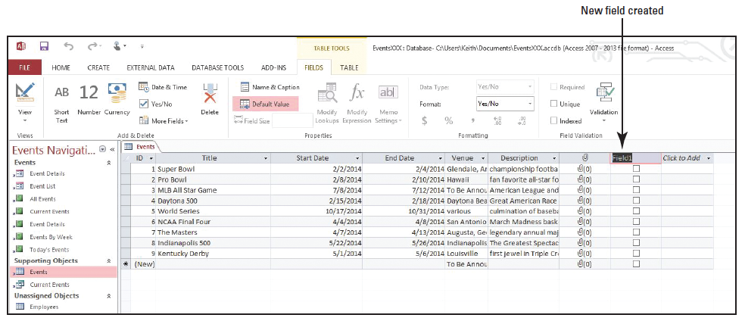
Step by Step: Create Fields
A new field named Field1 is added, and the Click to Add column becomes the last column in the table (below).

Slide 26
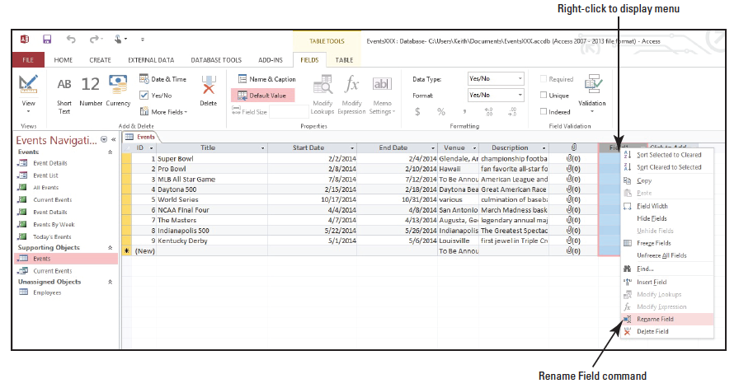
Step by Step: Create Fields
Right-click the Field1 column header to display the shortcut menu and click Rename Field (below).
Key On-site staff? as the column name.

Slide 27
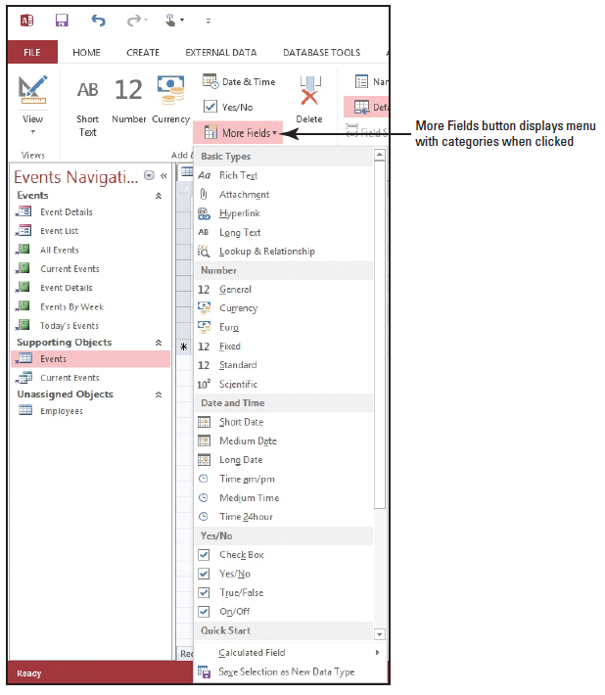
Step by Step: Create Fields
Click the More Fields button in the Add & Delete group on the Table Tools Fields contextual tab. The More Fields menu appears (right).

Slide 28
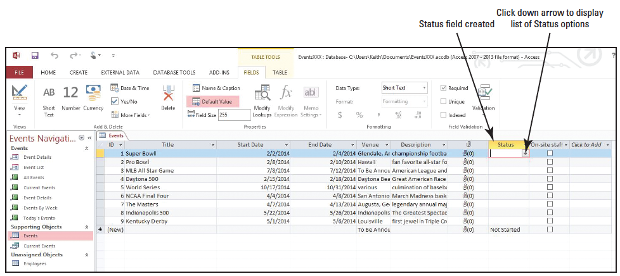
Step by Step: Create Fields
In the Quick Start category, click Status. A new Quick Start field named Status, in which you now have options to indicate the status of an event, appears to the left of the On-site Staff? field (below).

Slide 29
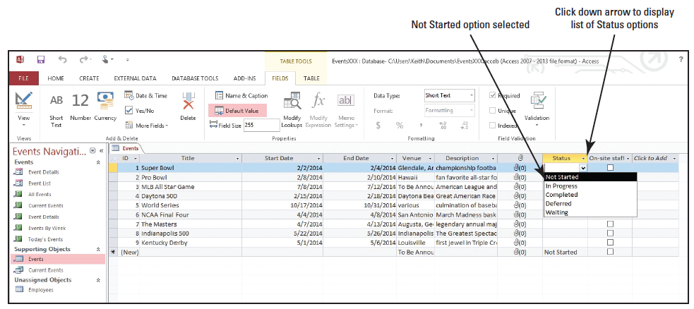
Step by Step: Create Fields
Click the Status field drop-down box button to view the available options, and click Not Started (below).
PAUSE. LEAVE the database open to use in the next exercise.

Slide 30
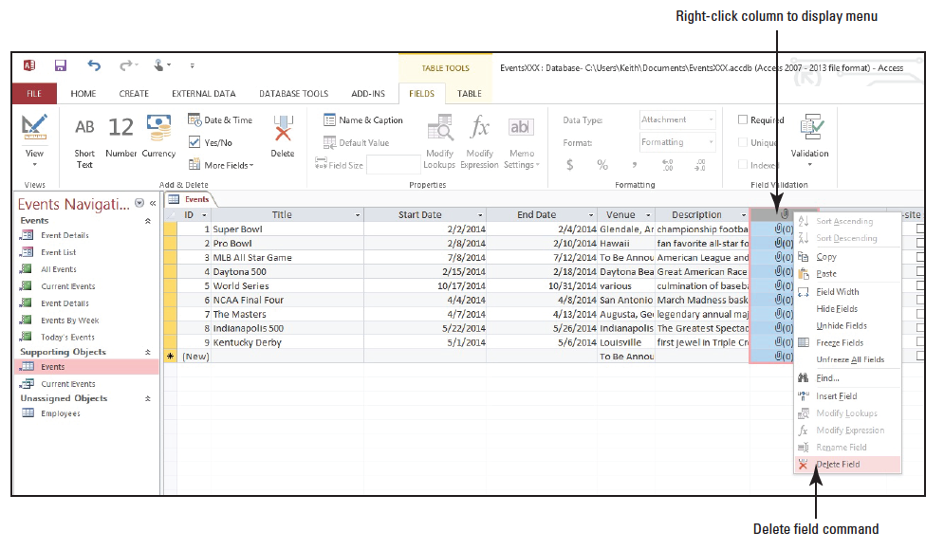
Step by Step: Delete a Field
USE the database that is open from the previous exercise.
Click the column header for the Attachment field, located between the Description field and the Status field.
Right-click on the column header to display the shortcut menu and click Delete Field (right).

Slide 31
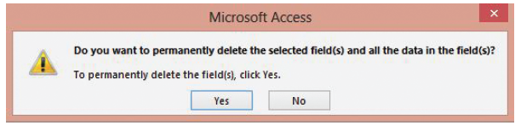
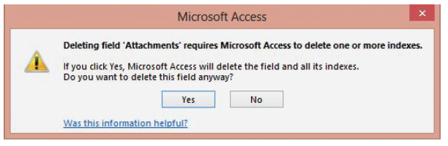
Step by Step: Delete a Field
A message appears (above). Click Yes.
A confirmation message appears (below). Click Yes. The field is deleted.

Slide 32
Step by Step: Delete a Field
Click the column header for the Status field.
Right-click in the column to display the shortcut menu then click Delete Field., In the message box that appears, click Yes to delete the Status field.
PAUSE. LEAVE the database open to use in the next exercise.

Slide 33
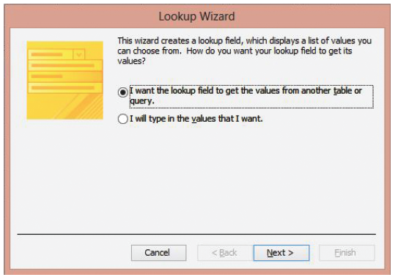
Step by Step: Create a Multivalued Lookup Field
USE the database that is open from the previous exercise.
Place the insertion point in the first cell of the table. Click the More Fields button in the Add & Delete group on the Table Tools Fields contextual tab, then click the Lookup & Relationship button. The Lookup Wizard appears (above).

Slide 34
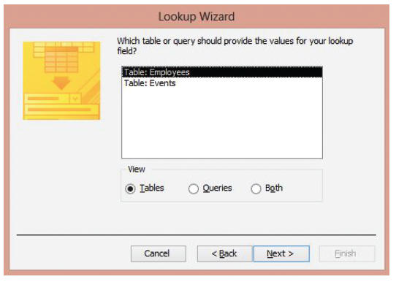
Step by Step: Create a Multivalued Lookup Field
Click Next > to accept the default setting (I want the lookup field to get the values from another table or query) and display the next screen in the Lookup Wizard (right). Notice you have a choice of two tables to provide the values for the lookup field you are creating. The first table, Employees, should already be selected for you.

Slide 35
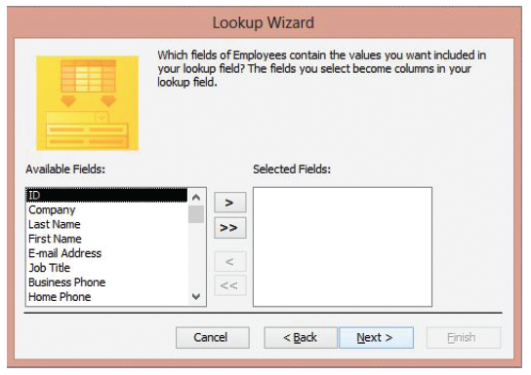
Step by Step: Create a Multivalued Lookup Field
Click Next > to accept the default settings and display the next screen in the Lookup Wizard (right). The Available Fields scroll box contains all the fields of the Employees table, two of which you will select since they contain the values you want to eventually look up.

Slide 36
Step by Step: Create a Multivalued Lookup Field
In the Available Fields list, select Last Name, then click the > button to move it to the Selected Fields box.
In the Available Fields list, select First Name, then click the > button to move it to the Selected Fields box.
Click Next > to accept your settings and display the next screen in the Lookup Wizard.

Slide 37
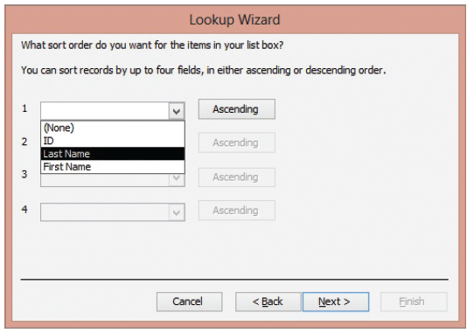
Step by Step: Create a Multivalued Lookup Field
Click the down arrow in the first box and click Last Name (below). This will sort the Lookup column in alphabetical order by Last Name.

Slide 38
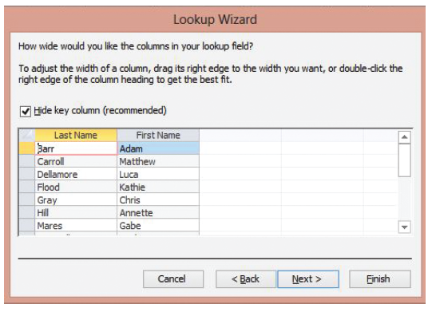
Step by Step: Create a Multivalued Lookup Field
Click Next > to accept your selection and to display the next screen in the Lookup Wizard (below).

Slide 39
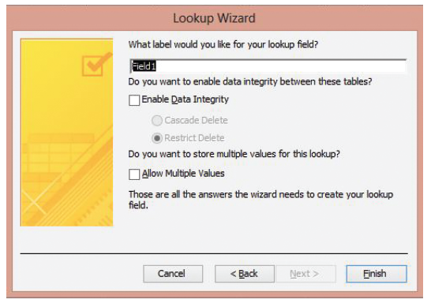
Step by Step: Create a Multivalued Lookup Field
Click Next > to accept the default selection and to hide the primary key column to ensure only relevant and meaningful data displays in the lookup column later. The final screen of the Lookup Wizard displays (below).

Slide 40
Step by Step: Create a Multivalued Lookup Field
In the What label would you like for your lookup field? box, key Coordinator. This will create a new label named Coordinator for your column.
Select the Allow Multiple Values check box to allow for the multiple selections of values.

Slide 41
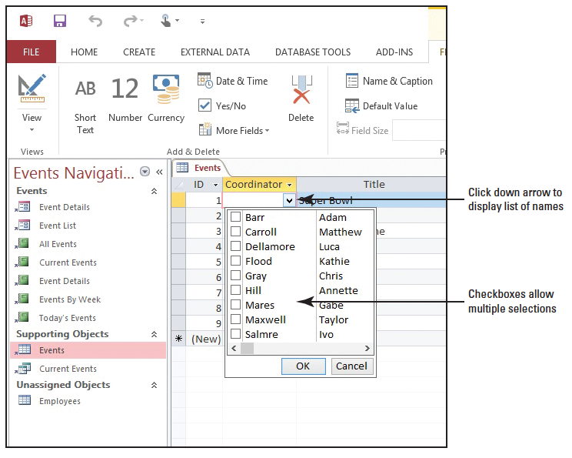
Step by Step: Create a Multivalued Lookup Field
Click the Finish button. A new column named Coordinator appears after the ID field. Click the down arrow in the first cell to display the list of names (right).
Click Flood/Kathie and Mares/Gabe on the list and then click OK to choose those multiple values for the field.
STOP. CLOSE the database.

Slide 42
Skill Summary

